Slide 1
Full Stack Development with F# & SAFE
Roman Provazník
@rprovaznik | @fsharping
Dotnet Days 2019 | 2. 11. 2019

Slide 2
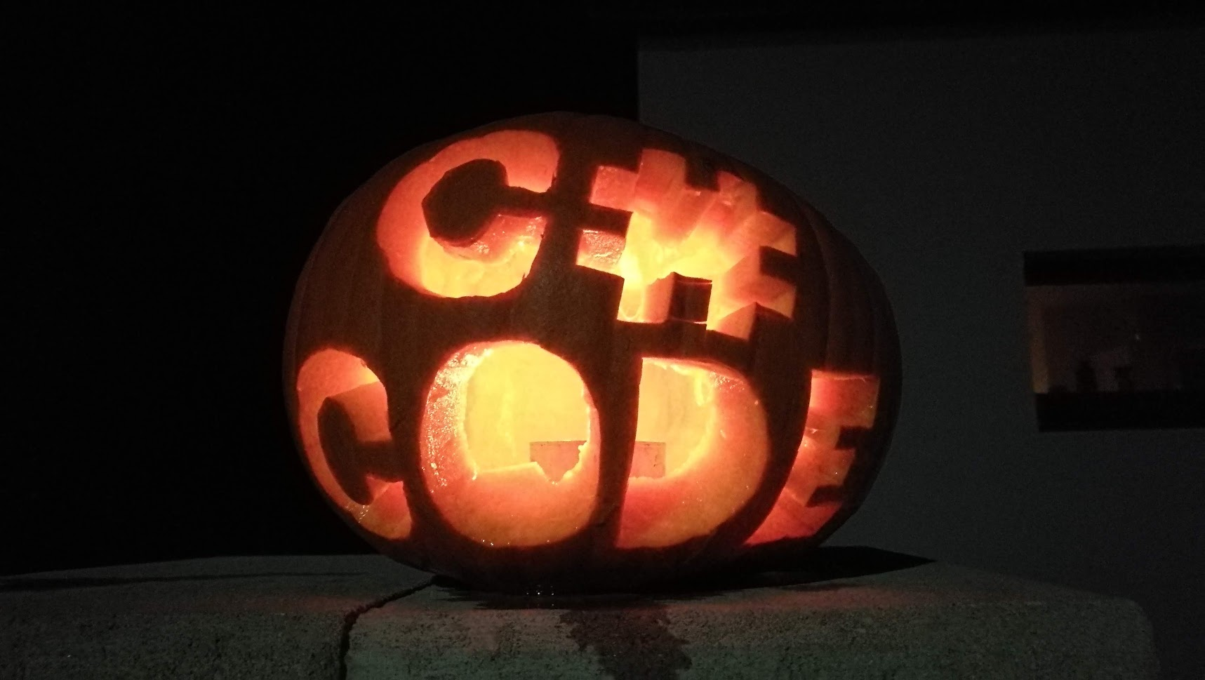

Slide 3
About me
F# Lead Developer @ CN Group CZ
Founder of Czech F# community (FSharping.com)
Speaker, F# evangelist

Slide 4
What is this talk about?

Slide 5
What is F#?
Quick introduction

Slide 6
F#
Multiparadigm
Strongly typed
.NET language

Slide 7
F#
1st version in May 2005
Author: Don Syme (Microsoft Research, Cambridge)
Current version 4.7.0

Slide 8
That was quick, wasn’t it?
But don’t be afraid, you’ll see a lot of F#!

Slide 9
Top 5 key concepts
Well… not so quick introduction, but still not hundreds of slides so you’ll have no problem to keep up. But you need to remember all of it.
Sorry…

Slide 10
#1 .NET language

Slide 11
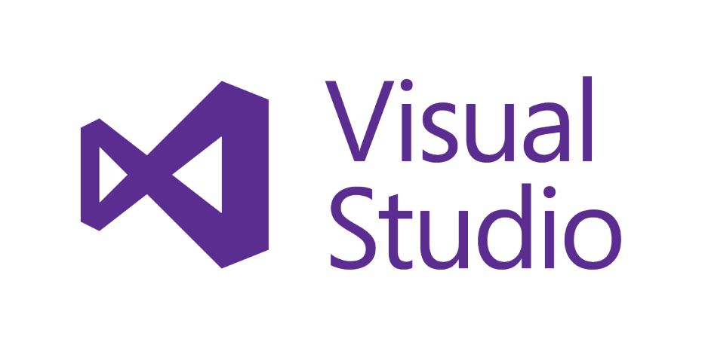
F# is .NET language
F# support in various IDEs
Developers coming from other .NET languages know the platform
Interop with C# code (both directions)
All favorite frameworks & libraries available via NuGet

Slide 12
#2 Multiple paradigms

Slide 13
F# allows multiple paradigms
OOP!
FP!

Slide 14
F# allows multiple paradigms
Why not both?

Slide 15
F# allows multiple paradigms
F# takes the best from both worlds
You can use interfaces, abstract classes, inheritance...
...as well as high-order functions, anonymous functions, currying, algebraic data types, etc...

Slide 16
Functions as „first-class citizen“
Functions can be composed
Functions can be sent as parameter or returned (high-order functions)
You can work with functions as with data
[ hasValidEmail userDoesNotExist usernameLongerThan 5 ] |> validate personDTO
[ add multiply subtract ] |> List.map (fun f -> f 20 10)

Slide 17
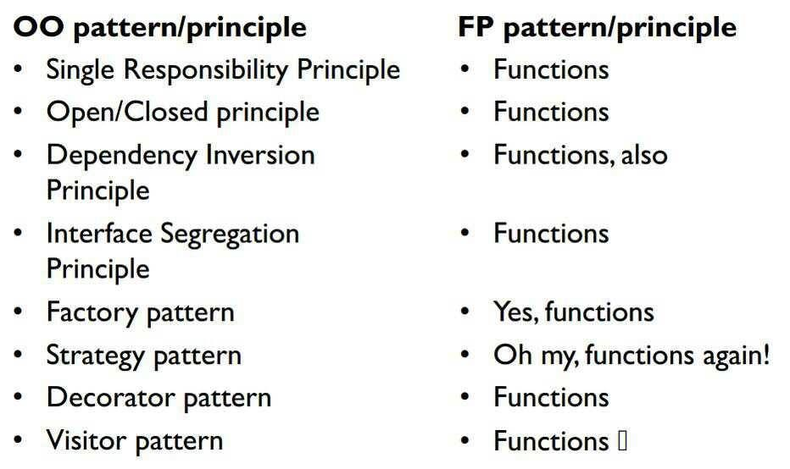
Functions as „first-class citizen“

Slide 18
#3 Subtle syntax

Slide 19
F# syntax
ML syntax - based on Ocaml
(almost) no semicolons
(almost) no brackets

Slide 20
F# syntax
let add x y = x + y
Function name
Parameters
Function body

Slide 21
F# syntax
let add x y = x + y
Scope

Slide 22
F# syntax
let add x y = x + y
Less of visual “mess”
Focus on what really matters (code!)
Perfect for custom DSL
vs
namespace Math { public static class Helpers { public static int Add(int x, int y) { return x + y; } } }

Slide 23
F# syntax
Less writing = less reading
Faster refactoring
Boosted by Type inference
[1..100] |> List.filter (fun x -> x%2 = 0) |> List.map (fun x -> x * 2) |> List.rev

Slide 24
F# syntax
“|>” applies parameter on left side as last parametr on right side
(List.rev (List.map (fun x -> x * 2) (List.filter (fun x -> x%2 = 0) [1..100])))
vs
[1..100] |> List.filter (fun x -> x%2 = 0) |> List.map (fun x -> x * 2) |> List.rev
Code written (and read) as normal English text

Slide 25
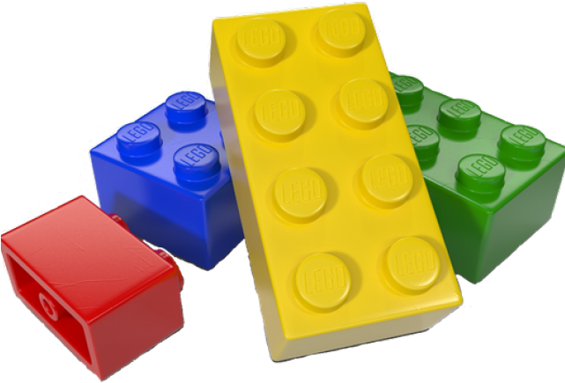
F# syntax
Compose smaller pieces (functions) into bigger pieces (functions)
Using “>>” operator
let add10 x = x + 10 let add90 x = x + 90 let add100 = add10 >> add90

Slide 26
#4 Enhanced safety

Slide 27
Immutability all the way
All F# types are immutable (cannot be changed)
Native support for easy “copying” of new values
Easy to parallelize
Easy to test
let roman = { Name = "Roman"; Role = "F# freak" } // nope! roman.Name <- "John" let john = { roman with Name = "John" }

Slide 28
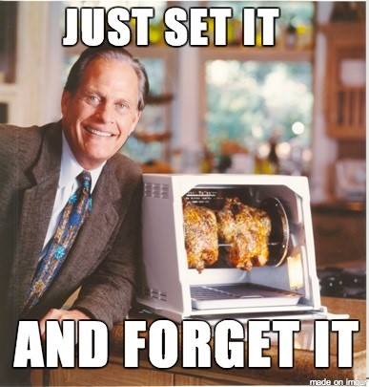
Immutability all the way
You can’t break what you can’t change

Slide 29
Algebraic data types
SUM types
Product types
Discriminated unions
Records, Tuples
type Payment = | Cash of amount:int | BankCard of int * card:int64 | Barter of description:string
type Person = { Name : string Role : string } let anonRec = {| X = 123.45 |} let nameAndAge = "Roman", 37
type Tree<'T> = | Branch of 'T * Tree<'T> list | Leaf of 'T

Slide 30
Algebraic data types
„Essential“ data type for DDD and domain modeling
Swiss knife for making custom DSLs in F#
100% safe during compilation – invalid state cannot be compiled
type Points = Zero | Fifteen | Thirty | Fourty type Player = A | B type Game = | Score of Points * Points | Advantage of Player | Victory of Player
type Result<'a> = | Success of 'a | ErrorMessage of string
type UserId = UserId of Guid

Slide 31
Algebraic data types
Universal language to communicate with customer
No need for UML!
Automatically warns about edge-cases (exhaustive pattern matching)
type Payment = | Cash of amount:int | Credits type IndividualLesson = | Available | Reserved of personId:Guid | Full of personId:Guid * pay:Payment
Model your domain & discuss with customer directly in IDE!

Slide 32
NULL in F#
All F# types are non-nullable
For not always present value union type Option (keyword „option“) is used
Pattern matching instead of defensive programming
type Person = { Name : string Age : int option }
type Option<'a> = | Some of 'a | None
match maybeValue with | Some x -> sprintf "Huraaaaay, we have %A" x | None -> "Sorry, nothing there"

Slide 33
NULL in F#
NULL is one of the biggest mistakes in history of programming!
Option type solves this problem – less null-checks, less code, more type safety
Option values can be combined in FP manner – bind, map, fold, iter...

Slide 34
#5 Pattern matching

Slide 35
Pattern matching
Patterns are rules for transforming input data.
They are used to compare data with a logical structure(s), decompose data into constituent parts, or extract information from data in various ways.

Slide 36
Pattern matching
It is something like SWITCH...
on heavy drugs…

Slide 37
Pattern matching
let showScore (g:Game) = match g with | Victory p -> sprintf "Player %A won" p | Advantage p -> sprintf “Player %A advantage" p | Score (a, b) when a = Fourty && b = Fourty -> “It is a DEUCE!" | Score (a, b) -> sprintf “Score is %A:%A" a b
Allows code branching by pattern
Checks unhandled branches (exhaustive pattern matching)
Can be used on most of F# types (records, tuples, lists, ...)

Slide 38
Pattern matching
type Permissions = Read | Write type Access = Admin | Limited of Permissions type User = { Login : string Rights: Access } let displayLogin user = match user with | { Login = "Jakub" } -> "Hi Jakub!" | { Rights = Admin } -> "Please be generous god!" | { Login = l; Rights = Limited(perm) } -> match perm with | Read -> sprintf "You are %s and you can read only" l | Write -> sprintf "You are %s and you can write" l
Can be used for deeper data structures

Slide 39
Pattern matching
Keeps your code clean
Improves visibility of your data flow
Forces you to think about all possible cases

Slide 40
Top 5 F# concepts
.NET language
Subtle syntax
Multiple paradigms
Enhanced Safety
Pattern matching

Slide 41
What is SAFE Stack?
Another quick introduction

Slide 42
SAFE Stack
Open-source F# end-to-end development stack
https://safe-stack.github.io
Shared code for backend & frontend
Ready to take .NET Core templates
Saturn/Suave
Azure
Fable
Elmish

Slide 43
Backend part – “S”
Mostly built on ASP.NET Core
Functional approach (Suave, Giraffe)
MVC-like approach (Saturn)
„Traditional“ REST services or backend-generated web

Slide 44
Infrastructure part – “A”
Prepared deployments to multiple cloud environments Azure, Google Cloud, Heroku, …
Prepared integration with Azure Services (AppInsights)
Docker support

Slide 45
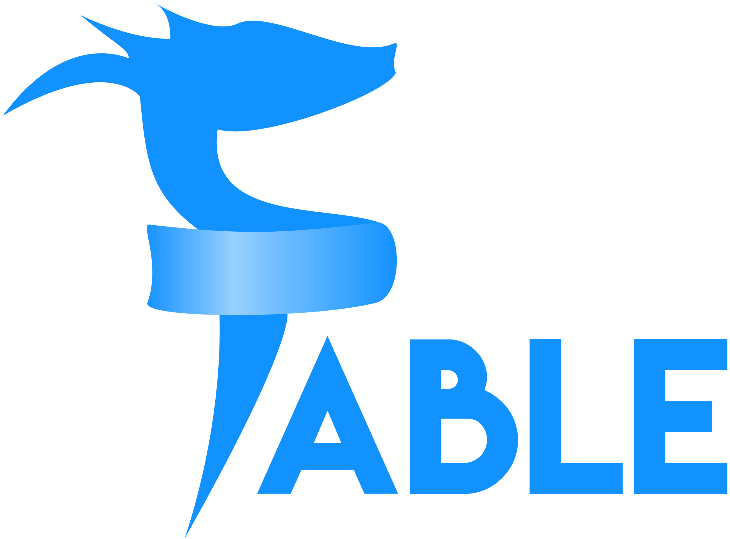
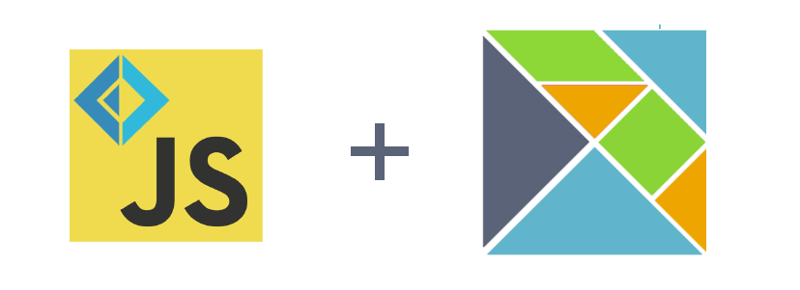
Frontend part – “F”
Fable (https://fable.io) F# to Javascript compiler
Interop with existing JS libraries via bindings
Based on Elmish MVU architecture

Slide 46
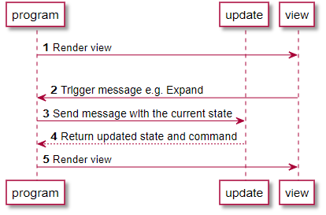
Architecture part – “E”
Elmish MVU pattern
Model – application state
View – returns HTML components tree for state (Model) + triggers Commands
Update – returns new Model based on existing Model and current Command

Slide 47
SAFE Stack

Slide 48
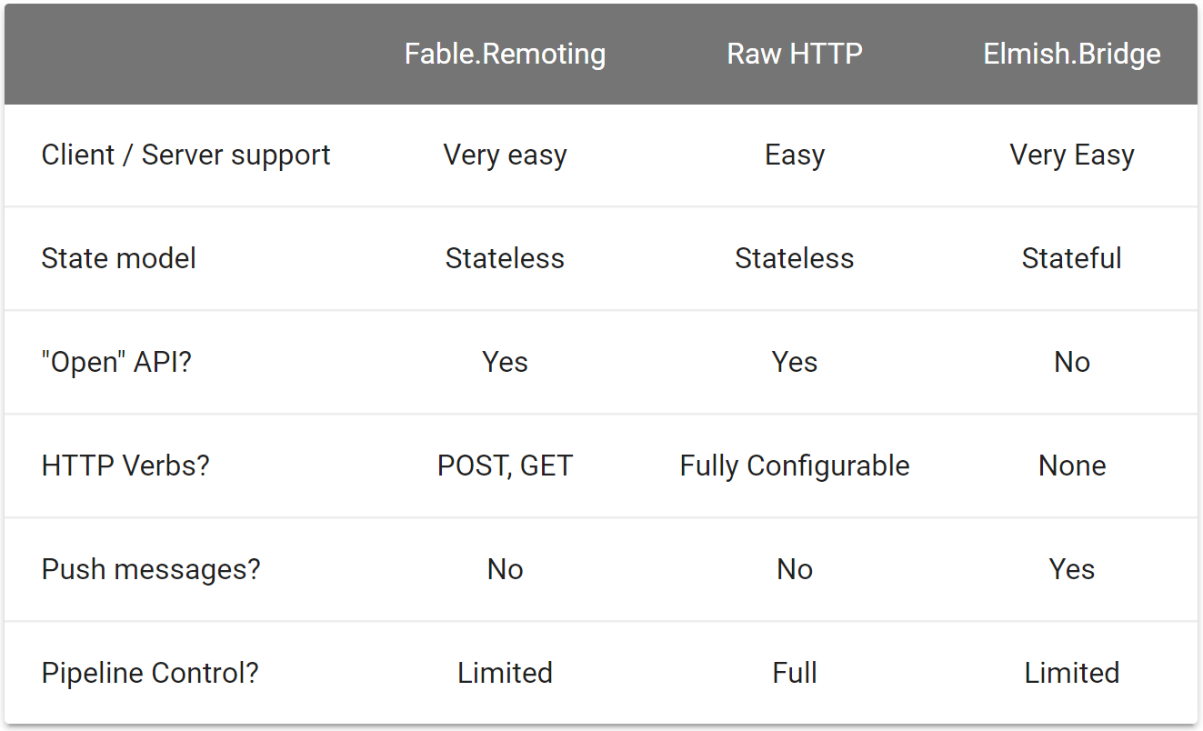
Backend ⬄ Frontend communication

Slide 49
How to start
Stay tuned, we are close to DEMO!
…finally

Slide 50
How to start
Install .NET template
Create new project
Build & run the app
dotnet new -i SAFE.Template
dotnet new SAFE
fake build --target run

Slide 51
DEMO
Finally!!!

Slide 52
Summary
F# is COOL!
SAFE STACK is COOL!

Slide 53
Where to go next?
Source code - github.com/Dzoukr/Talks/tree/master/2019/dotnet-days
F# Foundation – fsharp.org
Czech F# meetup – fsharping.com
F# Bible – fsharpforfunandprofit.com
Fable – fable.io
SAFE Stack – safe-stack.github.io

Slide 54
Next FSharping – 13. 11. 2019
Édgar Sánchez Gordón
FsBolero & WebAssembly in F#

Slide 55
THANK YOU!
Roman Provazník
@rprovaznik | @fsharping
Dotnet Days 2019 | 2. 11. 2019

